Slide 1

How to Achieve Efficiency? Learning with “eFishN’Sea” based on Real-World Software Performance Issues
Guest Lecture for SSW345
Professors: Lu Xiao, Eman Alomar, Andre Bondi, and Yu Tao
Senior Design Team (2023): Andrew Quinlan, Jonathan Morrone, Ryan Mercadante, Vincent Tufo

Slide 2





Meet the Team
Lu Xiao
lxiao6@stevens.edu
Associate Professor
Department of Systems and Enterprises
Stevens Institute of Technology
Eman Alomar
ealomar@stevens.edu
Assistant Professor
Department of Systems and Enterprises
Stevens Institute of Technology
Andre Bondi
abondi@stevens.edu
Senior Research Scientist
Department of Systems and Enterprises
Stevens Institute of Technology
Yu Tao
abondi@stevens.edu
Associate Professor
School of Humanities, Arts and Social Sciences
Stevens Institute of Technology
NSF CAREER: An AI Empowered Architecture-Centric Framework for Systematic Software-Performance Optimization
NSF DUE: Cultivating Performance-Aware Software Engineers

Slide 3







Meet the Team
Andrew Quinlan
Requirements and Risk Manager
Vincent Tufo
System Architecture Lead
Software Engineering
Dr. Yutong Zhao
Former Ph.D. student of Dr. Lu Xiao
Assistant Professor
Computer Science & Cybersecurity MIC D260 yutongzhao@ucmo.edu (660) 543-6615
Software Engineering
Class of 2023
Jonathan Morrone
Build Meister and System Administrator
Ryan Mercadante
Community Outreach and Test Lead

Slide 4
Today’s Agenda
(15 min) What is software performance and how are real-world performance issues caused and resolved?
(30 min) Learn with eFishN’Sea: https://efish-n-sea.github.io/
(15 min) Wrap-up
Survey
Simulation Assignment (Bonus)
Close

Slide 5



What is Software Performance?
Software performance describes the ability to meet business and engineering needs for short response times, high throughput, and memory requirements
Performance issues happen when software fails to meet such requirements, examples include:
Long execution time
Program blocking
Battery draining so fast…

Slide 6


Consequences of Software Performance Issues
“Users are more likely to switch to competitors’ products due to performance bugs than due to other general bugs”[1]
[1] Zaman, Shahed, Bram Adams, and Ahmed E. Hassan. "A qualitative study on performance bugs." Proceedings of the 9th IEEE Working Conference on Mining Software Repositories. IEEE Press, 2012.

Slide 7




Examples of Software Performance Bugs
Skype Infinite Loop Bug (2013): In 2013, a bug was discovered in Skype's Android app that caused an infinite loop during sign-in, resulting in excessive CPU usage and draining device battery.
Amazon AWS S3 Outage (2017): In February 2017, an Amazon Web Services (AWS) S3 service disruption occurred and led to a widespread outage affecting many websites and online services that relied on AWS S3 for storage and retrieval of data. The performance bug caused a significant slowdown and, in some cases, complete unavailability of services.
Twitter Hashtag Bug (2013): In July 2013, Twitter experienced a performance bug related to the handling of hashtags. When users inserted certain characters, such as a specific string of Arabic characters, it triggered a bug that caused a significant slowdown in the service.
Chrome Extension Performance Degradation (2018): In 2018, a performance bug was discovered in certain Chrome extensions that resulted in excessive CPU and memory usage. The bug caused the extensions to consume more system resources than necessary, leading to sluggish browser performance and reduced responsiveness.

Slide 8


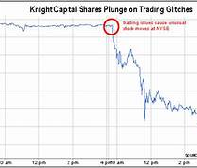
It could get worse…
The Ariane 5 rocket failure in 1996 is related to converting a 64-bit floating-point number to a 16-bit signed integer that impacted the rocket’s performance and contributed to the system shutting down and the rocket self-destructing.
Knight Capital Group Trading Loss (2012): A software bug in Knight Capital Group's trading software caused the company to incur a massive financial loss of approximately $440 million in just 45 minutes. This financial impact directly related to the performance of the trading system and its ability to execute trades accurately and efficiently.
The Boeing 737 MAX crashes in 2018 and 2019 were related to software performance issues, specifically involving the Maneuvering Characteristics Augmentation System (MCAS). The performance-related aspect of this issue relates to the system's response time and behavior. The MCAS responded to incorrect sensor data by initiating automatic nose-down trim adjustments, which the flight crews were unable to override in some instances. This unexpected and aggressive behavior by the MCAS resulted in the aircraft entering a state of unrecoverable flight, leading to the crashes.

Slide 9

How are performance issues caused and resolved?
We conducted a comprehensive study that involves 570 real-world performance issue reports from 13 open-source projects, in Java, C/C++, and in Python.
We found eight recurring causes to performance issues and their corresponding resolutions:
Inefficient Data Structure
Inefficient Iteration
Inefficient API Usage
Inefficient Synchronization
Redundant Data Processing
Repeated Computation
Inefficiency Under Special Cases
General Inefficient Computation
Zhao, Yutong, Lu Xiao, Andre B. Bondi, Bihuan Chen, and Yang Liu. "A Large-Scale Empirical Study of Real-Life Performance Issues in Open-Source Projects." IEEE Transactions on Software Engineering (2022).

Slide 10



Inefficient Data Structure
Cause:
The choice of an inefficient data structure consumes a large amount of memory and/or takes a long time.
Resolution
Replacing the inefficient data structure by a more efficient data structure.
Imagine you're organizing a closet. You have a bunch of items like clothes, shoes, and accessories that need to be stored in an efficient way so you can easily find and retrieve them later. In this case, the closet is like a data structure.

Slide 11
Inefficient Data Structure
Although each of the three programming languages has its specific data structures, the sub-optimal choice of data structure could occur with any of them.
For example, in issue PDFBOX-410 (Java), developers replaced StringBuffer with StringBuilder to improve the efficiency of text loading;
in issue LIBCLOUD-254(Python), developers replaced LazyList data structure by a simple iteration;
in issue MESOS-2126 (C++), developers replace the Queue by Vector, since Vector does dynamic allocation only when necessary to reduce CPU cache usage in most cases.
https://issues.apache.org/jira/browse/pdfbox-410.[63] https://issues.apache.org/jira/browse/libcloud-254.[64] https://issues.apache.org/jira/browse/mesos-2126.

Slide 12

Repeated Computation
Cause:
A program repeatedly performs the same computation and produces the same output.
Resolution
1) store the output in a cache or a buffer for re-using; and 2) only perform the computation when the program status changes.
Imagine you are a student preparing for an exam. You have a set of practice questions that you go through repeatedly to review and reinforce your knowledge. To make your study process more efficient, you could create flashcards with the questions and their correct answers.

Slide 13
Repeated Computation
Issue PDFBOX-599 addresses a performance inefficiency in the TextPosition class, specifically within the getX() and getY() methods. To enhance performance, the TextPosition class was modified to cache the X and Y coordinates upon their first computation. Subsequent calls to getX() and getY() would then return the cached values, eliminating redundant calculations.
public class TextPosition {
private float x = Float.NEGATIVE_INFINITY;
private float y = Float.NEGATIVE_INFINITY;
public float getX() {
if (x == Float.NEGATIVE_INFINITY) {
x = getXRot(rot);
}
return x;
}
public float getY() {
if (y == Float.NEGATIVE_INFINITY) {
if ((rot == 0) || (rot == 180)) {
y = pageHeight - getYLowerLeftRot(rot);
} else {
y = pageWidth - getYLowerLeftRot(rot);
}
}
return y;
}
// Other methods and fields...
}

Slide 14

Inefficient Iteration
Cause:
The status of loop iterations remains the same and the iterations become useless
Resolution
Check whether the loop status becomes stable; if so, break and exit the loop.
Imagine you are your desk and you have a stack of papers that need to be sorted and filed. However, you encounter a problem where you keep picking up the same paper over and over again, even though you've already sorted it into the correct folder.

Slide 15
Inefficient Iteration
Issue PDFBOX-1447 addresses a performance inefficiency in the PDFMarkedContentExtractor class, where the original implementation contained a loop that continued iterating even after a condition was met, leading to unnecessary computations.
To enhance performance, the loop was modified to exit immediately after setting suppressCharacter to true, eliminating redundant iterations:
for (TextPosition character : sameTextCharacters) {
if (textPosition.equals(character)) {
suppressCharacter = true;
}
}
for (TextPosition character : sameTextCharacters) {
if (textPosition.equals(character)) {
suppressCharacter = true;
break; // Exit loop after condition is met
}
}

Slide 16


Inefficient API Usage
Cause:
Many different APIs provide the same or similar functionalities, but some APIs are more efficient than the others in certain context.
Resolution
Replace it with a more efficient one
Imagine you're a photographer capturing a beautiful sunset scene. You have two cameras to choose from: a high-end DSLR camera and a basic smartphone camera.

Slide 17
Inefficient API Usage
Before Optimization: Using new Long(): In the initial implementation, creating a Long object with new Long() results in the instantiation of a new object each time, even for frequently used values.
// Before optimization
Long result = new Long(100L)
After Optimization: Using Long.valueOf(). The optimized approach replaces new Long() with Long.valueOf(), which leverages Java's caching for Long values between -128 and 127. For values within this range, Long.valueOf() returns a cached instance, reducing memory usage and improving performance.
// After optimization
Long result = Long.valueOf(100L)
https://issues.apache.org/jira/browse/GROOVY-5164

Slide 18
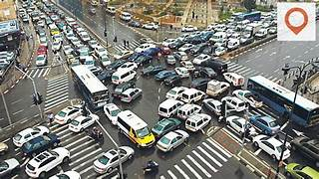
Inefficient Synchronization
Cause:
These performance problems are caused by the synchronization issues among multiple threads.
Resolution
Improve the synchronization mechanism
Imagine a busy intersection where multiple roads converge. Each road represents a different thread of traffic trying to navigate through the intersection. Efficient synchronization at the intersection ensures smooth traffic flow, minimal delays, and safe passage for all vehicles.

Slide 19
Inefficient Synchronization
Before Optimization: Contention Due to Static AtomicInteger. The categoriesInUse AtomicInteger is shared across all threads, causing contention when multiple threads access the hasCategoryInCurrentThread() method concurrently.
public class GroovyCategorySupport {
private static final AtomicInteger categoriesInUse = new AtomicInteger(0);
public static boolean hasCategoryInCurrentThread() {
return categoriesInUse.get() != 0 && threadInfo.getInfo().level != 0;
}
}
The optimization involves replacing the static AtomicInteger with a thread-local variable, ensuring that each thread maintains its own instance, thereby eliminating contention.
public class GroovyCategorySupport {
private static final ThreadLocal<AtomicInteger> categoriesInUse = ThreadLocal.withInitial(AtomicInteger::new);
public static boolean hasCategoryInCurrentThread() {
return categoriesInUse.get().get() != 0 && threadInfo.getInfo().level != 0;
}
}
https://issues.apache.org/jira/browse/GROOVY-4182

Slide 20

Redundant Data Processing
Cause:
Redundant or tedious data processing. For example, a typical scenario is processing (e.g., copying or initializing) a large chunk of data in small units, such as bit by bit, or pixel by pixel (in graph transformation).
Resolution
Use more efficient data processing strategy to avoid heavy iterative data processing, such as processing all the data in one go, or to eliminate unnecessary data processing.
Imagine you are a chef preparing a meal in a restaurant kitchen. As part of your recipe, you need to chop a large quantity of vegetables. However, instead of chopping them all at once, you decide to chop each vegetable piece by piece.

Slide 21
Redundant Data Processing
Issue COLLECTIONS-409 addresses a performance problem in the ListOrderedSet.addAll() method. The original implementation added each element individually at a specified index, leading to inefficient operations when inserting multiple elements.
To enhance performance, the method was optimized to add all elements at once, reducing the need for repeated shifting of elements:
public boolean addAll(int index, Collection<? extends E> coll) {
boolean modified = false;
for (E e : coll) {
if (set.add(e)) {
setOrder.add(index++, e);
modified = true;
}
}
return modified;
}
public boolean addAll(int index, Collection<? extends E> coll) {
boolean modified = false;
List<E> tempList = new ArrayList<>(coll.size());
for (E e : coll) {
if (set.add(e)) {
tempList.add(e);
modified = true;
}
}
if (modified) {
setOrder.addAll(index, tempList);
}
return modified;
}

Slide 22


Inefficiency Under Special Cases
Cause:
The program runs well most of the time, but it becomes extremely slow or causes memory bloat in special cases.
Resolution
1) add checking conditions for the special cases, and 2) employ special algorithms to treat each special case efficiently.
Imagine you are a gardener taking care of a beautiful garden with various types of flowers. Most of the time, you water the flowers using a standard watering can, and it works well for the majority of plants. However, there are certain delicate flowers that require a more gentle watering approach.

Slide 23
(In)efficiency Under Special Cases
In GROOVY-2484, the unique() operation is slow because each number is converted to BigDecimal before comparison.
def numbers = (1..10000).collect { it.toDouble() } // Creates a list of Double numbers
def startTime = System.currentTimeMillis()
def uniqueNumbers = numbers.unique()
def endTime = System.currentTimeMillis()
println "Time taken with default NumberAwareComparator: ${endTime - startTime} ms"
The optimization involves modifying the NumberAwareComparator to first check if the elements are of the same type and are Comparable. If they are, it uses their natural ordering without converting them to BigDecimal.
class OptimizedNumberComparator implements Comparator {
int compare(Object o1, Object o2) {
if (o1 == o2) return 0
if (o1 == null) return -1
if (o2 == null) return 1
if (o1.class == o2.class && o1 instanceof Comparable) {
return ((Comparable) o1).compareTo(o2)
}
return new BigDecimal(o1.toString()).compareTo(new BigDecimal(o2.toString()))
}
}
https://issues.apache.org/jira/browse/GROOVY-2484

Slide 24
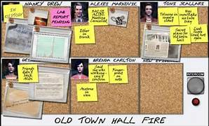
General Inefficient Computation
Cause:
These performance issues are caused by other general inefficient in the algorithm.
Resolution
They are usually addressed by specific algorithmic improvements.
Imagine you are a detective trying to solve a mystery. You have a list of suspects, and you need to determine if each suspect has an alibi and if they possess a motive for the crime. As you investigate each suspect, you consistently follow the order of checking the alibi first and then examining their motive.

Slide 25
General Inefficient Computation
The Apache Groovy issue GROOVY-6665 identified a problem where the maxRows parameter in groovy.sql.Sql was causing one extra row to be fetched beyond the specified limit.
while (groovyRS.next() && (maxRows <= 0 || i++ < maxRows)) {
rowClosure.call(groovyRS)
}
The conditions were reordered to ensure that the maxRows check occurs before advancing the cursor:
while ((maxRows <= 0 || i++ < maxRows) && groovyRS.next()) {
rowClosure.call(groovyRS)
}

Slide 26
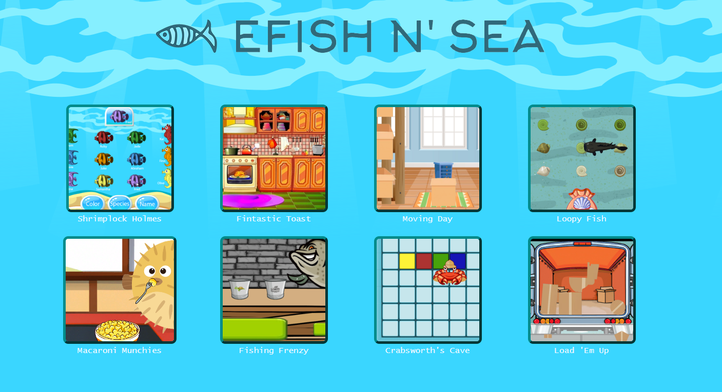
https://efish-n-sea.github.io/index.html
Survey with Each Game:
https://stevenshowe.co1.qualtrics.com/jfe/form/SV_d4sA3UII111o1ZY

Slide 27

Warp-Up
Please take the survey at the end of each game: https://stevenshowe.co1.qualtrics.com/jfe/form/SV_d4sA3UII111o1ZY
It is optional, totally up to you
It is a way for you to help us improve our games
We hope that you learned something useful here ☺

Slide 28
Stress Testing Simulation
Objective of Stress Testing: The primary objective of stress testing is to push a system beyond its normal operational limits to evaluate its stability, reliability, and ability to recover gracefully under extreme conditions. This ensures that the system can handle unexpected surges in demand and provides valuable insights into potential failure points and areas for improvement
Importance of Simulation in Stress Testing: Simulation is essential for stress testing because it enables us to recreate extreme, high-load scenarios in a controlled environment, without risking actual system downtime or impacting real users. Simulating stress conditions helps identify vulnerabilities, validate system resilience, and assess performance limits safely and cost-effectively, making it an indispensable part of thorough system testing.

Slide 29
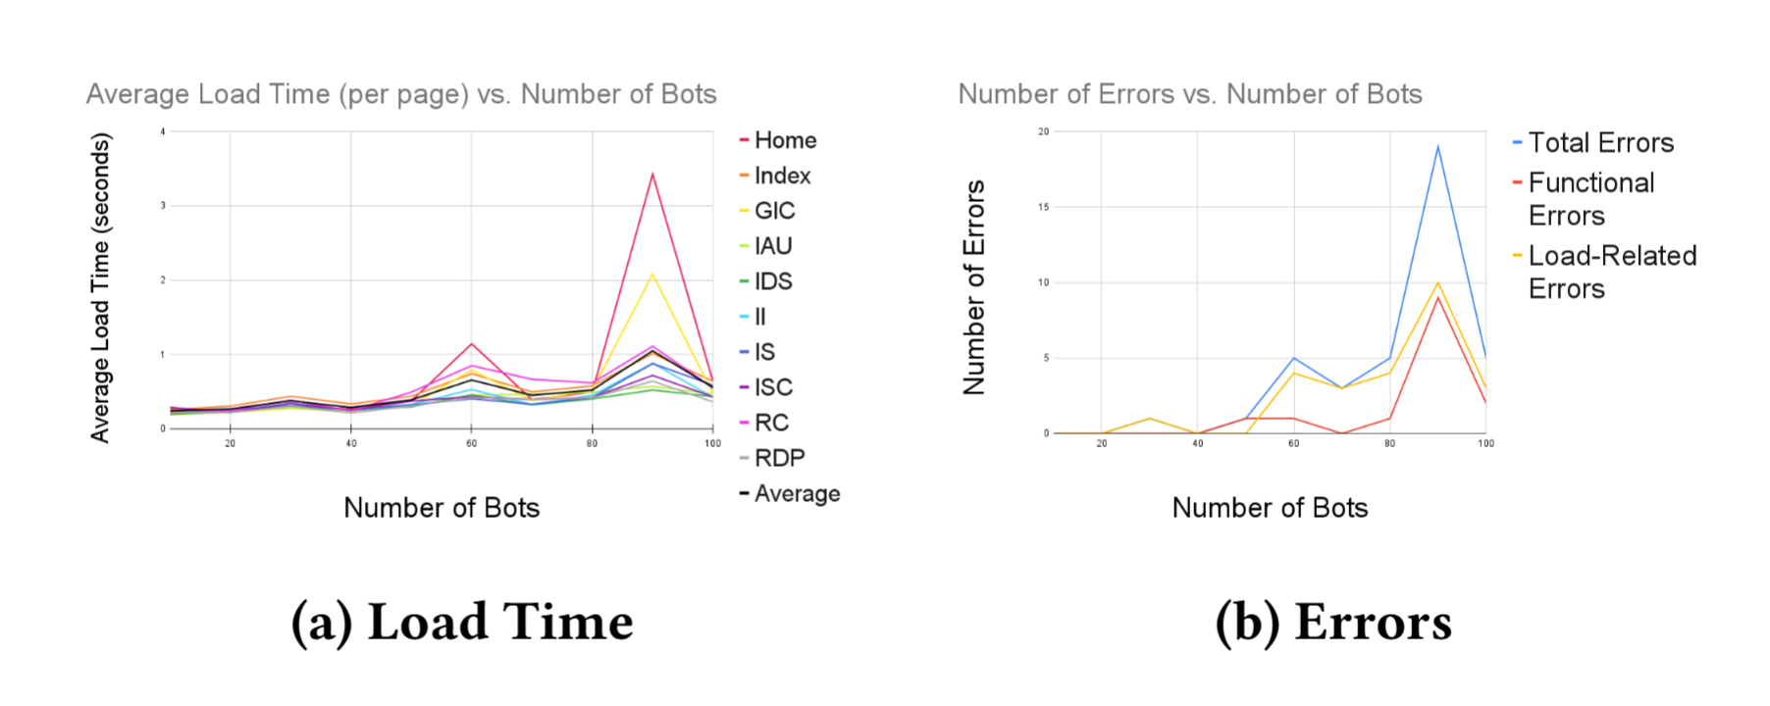
Stress Simulation of e-Fish-n-Sea
We used LoadTester, which is a commercial tool for web-basedstress testing with bots
https://loadster.app/

Slide 30
Bonus Assignment
Objective: Simulate stress testing on one eFish'nSea game to evaluate system performance under high load.
Setup:
Use Loadster for stress test simulation.
Follow step-by-step setup on GitHub: Tutorial on Stress Testing.
Usage Limit:
Stay within 50 free fuels provided by Loadster – plan tests carefully!
Test only one game within eFish'nSea to avoid exceeding limits.
Deliverables: Report including setup, collected data, analysis, and performance recommendations.
https://sit.instructure.com/courses/74549/assignments/540676

